Slide 1


Red Teaming Approaches, Rationales, Engagement Risks and Methodologies
© TM
Indiana University of Pennsylvania Information Assurance Day 2011
Session 3: 11-12 noon
IUP HUB Delaware Room

Slide 2
Goals for today
Define Red Teaming and its’ rationale
Discuss differences between commercial and full-spectrum Red Teaming
Discuss differences between commercial and full-spectrum methodologies
Examine common engagement risks
Application of Red Teaming methods
A companion document exists as supplemental reading resource for this presentation

Slide 3
Red Teaming Definitions
“An array of activity where the overall goal is to understand the adversaries perspective in order to identify one's own vulnerabilities and challenge one 's own assumptions.”¹
“Authorized, adversary-based assessment for defensive purposes.“²
“Review of control design and threat-based penetration testing to simulate actual attacks.”³

Slide 4
Commercial v. Full Spectrum
Lets explore the motivating factors for commercial and full-spectrum red teams
Commercial engagements
Full-Spectrum engagements
Threat-based modeling
Compliance mandates
IT Audit adjunct testing
Goal is quick penetration
Cost and time driven
Automation dependency
Survey the known
Capabilities-based or hybrid modeling
Simulations
Goal is understanding
Risk analysis driven
Human in the loop
Expand the knowable by parsing the unknown

Slide 5
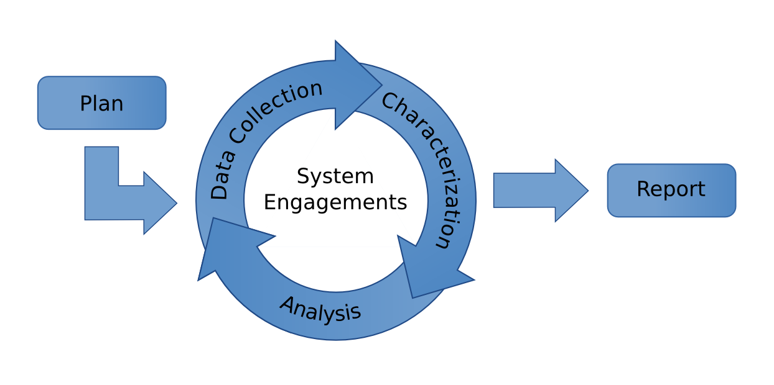
Methodologies
Commercial
Full Spectrum
Client Engagement
Master Service Agreement
Statement of Work
Rules of Engagement
Bond of Indemnity
Identify Scope
Reconnaissance
Source: Sandia National Laboratories IDART, 2011
Targeting
Reload
Scan & Attack
Compromise
Report

Slide 6
The Intelligence Process
⁴ Schudel, G. and Wood, B. (RAND, SANDIA & GTE: 2000)

Slide 7
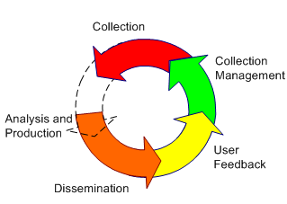
Intelligence Cycle
A full-spectrum red team will focus upon likely adversarial courses of action as well as current capabilities.
Internally to the team, a need exists to have common doctrinal understanding of resource identification, intelligence collection, collection management, training, and leadership.

Slide 8
Intel Fusion Approach
A red team collects and produces intelligence at variable rates and differing fidelities. The red team leader must be prepared for these eventualities.
⁵ Adapted from Steele, Robert, D. (New Craft of Intelligence: 2002)

Slide 9
Bias in the Intel process
Sources of cognitive error
Organizational and environmental bias indicators
Sources of cognitive error can be found in individual minds, the collective agreement of the team, team composition, and in the quality of support given to the effort. Each individual team member carries both a cognitive bias as the known outsider pre-judged by their own past experiences, as well as the bias of their culture.
The assignment is not taken seriously
The team or sponsor becomes too removed from the decision-making process
A lack of interaction with the blue team
Insufficient access to the details of the target
Loss of team confidences
The team fails to capture the details of the adversary, and instead mirrors itself
The red team does offers no challenge to the blue team
Thin top cover: the lack of a robust channel to act on findings in a timely manner, or consider findings with any seriousness.
Applied post-event after many bodies already have been thrown at the problem
The wrong team targeting the wrong problem (Threat-based team vs. a capabilities based problem)
A lack of clarity on the urgency of issues at hand
The red team approach is a one-time activity
⁶ Defense Science Board. Task Force Report on The Role and Status of Red Teaming Activities: (DoD: 2003)

Slide 10
Role play the Adversary
Lets explore the difference between a threat-based adversary model and capabilities-based adversary model.
Threat – A threat represents a known quantity, a known effect singular in origin, essentially a Pathogen-Antigen model. A threat is an X-Y direct, or inverse relationship.
Capability – Actors (or a confederation of multiple actors) capable of achieving a singular goal either due to access to resources, or some form of institutional support. The force multiplier effects of capability-based actors behave like an algebraic expression where leading factors have orders of magnitude, possibly even having orders of operation.

Slide 11
Adversarial Modeling
In the full-spectrum Red Team context, the sponsor may need more than one type of red team to realistically model the capability. In the commercial world, modeling capability-based actors is the exception, not the norm.
The Universe of Actors and Actions
Red Team A
Adversary
B
Red Team B
Adversary
A
Adversary
C
Source: Sandia National Laboratories IDART, 2011

Slide 12
Adversarial Prototyping
‥
⁷ Op. Cit. Schudel, G. and Wood, B. : 2000

Slide 13
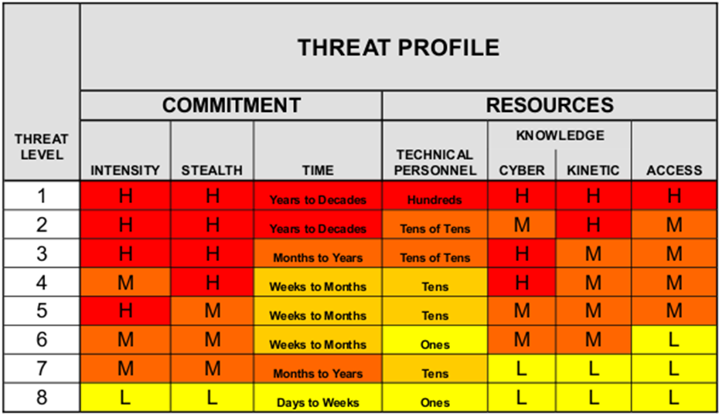
Threat Profiling
⁸ Duggan, et. al. SANDIA, 2007

Slide 14
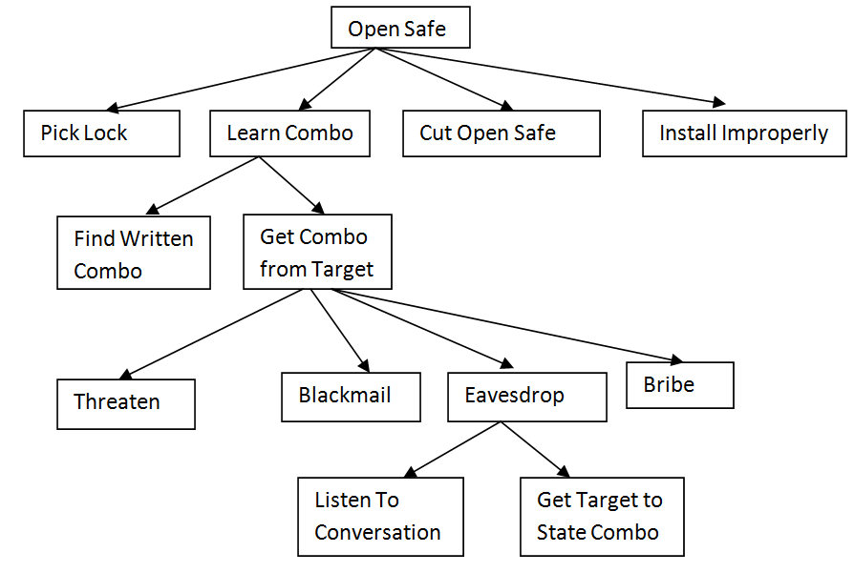
Attack Trees
⁹ Schneier, Bruce. Modeling Security Threats (Dr. Dobb’s Journal: 1999)

Slide 15

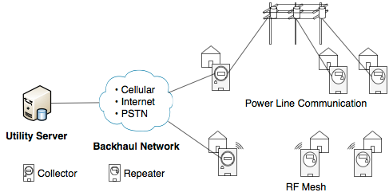

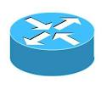

Smart Grid Attack Diagram
Corporate
Network
The Internet
DDR PSTN DID
1-(724)-got-powr
128K CSU/DSU
Link over carrier
¹⁰ Penn State University SIIS Laboratory. (Network and Security Research Center: 2010)

Slide 16
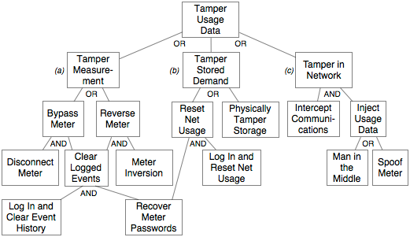
Smart Grid Attack Tree
¹¹ Ibid. Penn State University SIIS Laboratory: 2010

Slide 17
When to Use Red Teaming
¹² Atkins, William. Read Teaming – It's Good to be Bad. (Missouri S&T ACM SIG in Security: 2010)

Slide 18
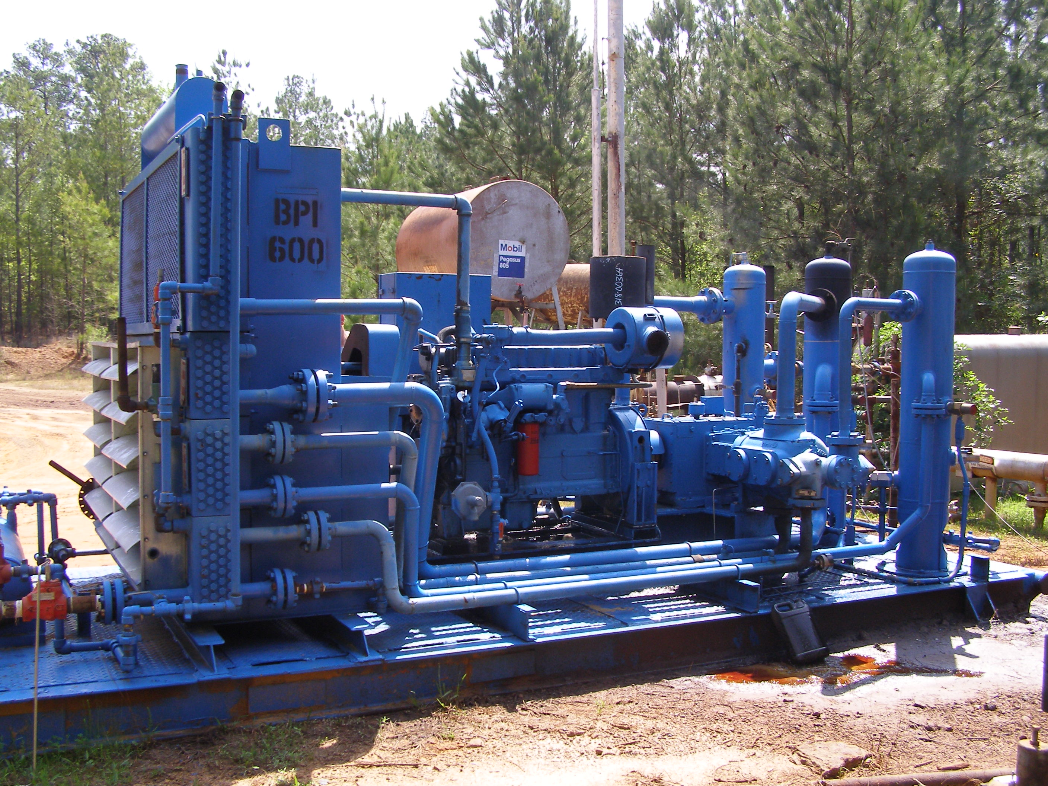
Ok, you try it now. Target: A reciprocating high-speed gas compressor
Source: BPI Compression 2011

Slide 19
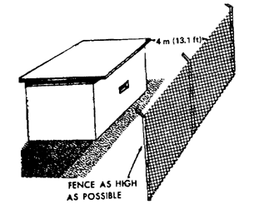
The red team simulation revealed complete destruction of the compressor and block house site plan in 10 minutes. What was the solution? Where are the vulnerabilities? why did the solution work?
Flood light
and CCTV
camera
½ ton pickup
A cinderblock
Fender Jack
Stump Remover
Mentos
Duct Tape
Magnesium Ribbon
2 black Super Fan Suits
Five 2L bottles of Cola
One 2L bottle of Clorox
1 Sling Shot
Estimated 3 weeks of site observation and rehearsal
It frequently rains here
Steel Door
No buried fence

Slide 20
Use your powers for the greater good, not evil.
Fight the Good Fight

Slide 21
References
McGannon, Michael. Developing Red Team Tactics, Techniques, and Procedures. (Red Team Journal: APR 2004). Internet. Found at http://redteamjournal.com/
Sandia IDART Methodology. http://idart.sandia.gov/methodology/index.html
Price Waterhouse Coopers. Is your critical infrastructure safe? (PWC LLP:2010) Internet. Found at http://www.pwc.com/en_US/us/industry/utilities/assets/cyber-attacks.pdf 5.
Schudel, G. and Wood, B. Modeling the Behavior of a Cyber Terrorist. (RAND National Security Research Division proceeding of workshop. Appendix C: Santa Monica, California: 2000) 49-59. Internet. Found at http://www.csl.sri.com/users/bjwood/cyber_terrorist_model_v4a.pdf.
Steele, Robert, D. The New Craft of Intelligence: Achieving Asymmetric Advantage in the Face of Nontraditional Threats. (U.S. Army War College Strategic Studies Institute: 2002). 34-36.
Department of Defense Science Board. Task Force Report on The Role and Status of Red Teaming Activities (Office of the Under Secretary of Defense For Acquisition, Technology, and Logistics. Washington, D.C. 20301-3140:2003). Internet. Found at www.au.af.mil/au/awc/awcgate/dod/dsb-redteam.pdf
Op. Cit. Schudel and Wood, 2000.
Duggan, David, P., Thomas, Sherry R., and Veitch, Cynthia K.K., and Woodward, Laura. Categorizing Threat - Building and Using a Generic Threat Matrix. (SANDIA National Laboratories, Albuquerque NM. REPORT SAND2007-5791: September 2007). Internet. Found at http://idart.sandia.gov/methodology/materials/Adversary_Modeling/SAND2007-5791.pdf
Schneier, Bruce. Modeling Security Threats - Attack Trees (Reprint Dr Dobb’s Journal: 1999. Counterpane Internet Security: 1999). Internet. Found at http://www.schneier.com/paper-attacktrees-ddj-ft.html
Penn State University SIIS Laboratory. Advanced Metering Infrastructure Security. (Penn State University Systems and Internet Infrastructure Security Laboratory, Computer Science and Engineering (CSE) Network and Security Research Center (NSRC): 2010). Internet. Found at http://siis.cse.psu.edu/smartgrid.html
Ibid. Penn State University, 2010
Atkins, William. Read Teaming – It's Good to be Bad. (Missouri S&T ACM SIG in Security. SANDIA Critical Infrastructure Systems Department, NM, 10 FEB 2010). Internet. Found at. http://acm.device.mst.edu/security-files/2010-02-10-Red_Teaming.ppt
‡ See the supplemental paper that accompanies this presetation titled : Yanalitis, Mark. RED TEAMING APPROACH,
RATIONALE, AND ENGAGEMENT RISKS (self-published: 2011). Internet. Found at http://www.mediafire.com

